Slide 1
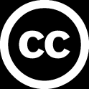
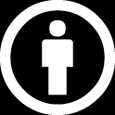
Introduction to TensorFlow
Portland Data Science Group Created by Andrew Ferlitsch Community Outreach
June, 2017

Slide 2

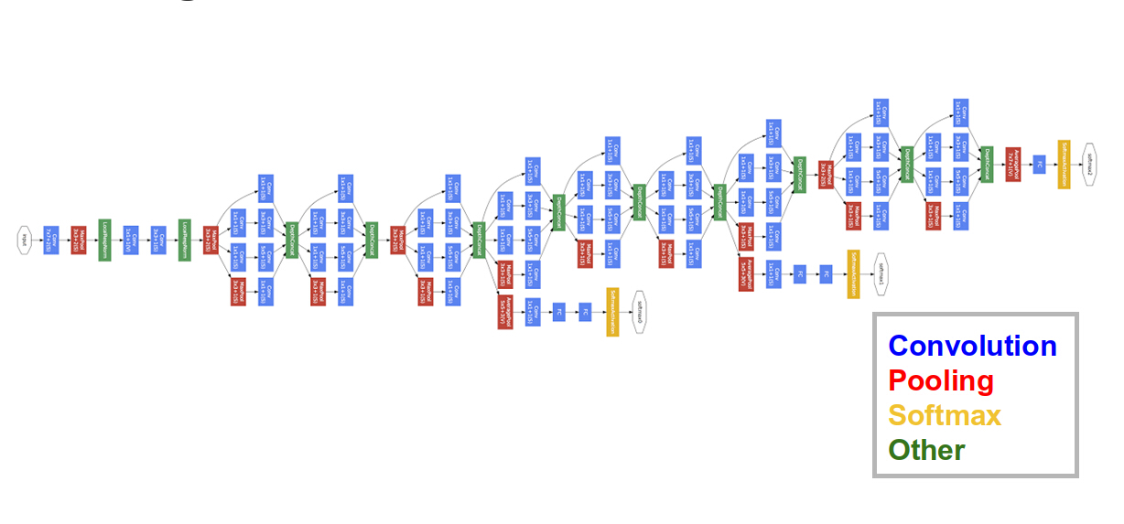
What is it?
An Open Source Machine Learning Library released by Google in 2015
Built on top of Google’s Inception v3
Google’s most advanced image recognition system
Convolution Neural Network (CNN)
Available as a Python (or C++) Library

Slide 3
Basics – What is a Vector?
A vector is an array of numbers.
Vector = [ number, number, … ]
In machine learning, a vector holds the feature values (variables) for a sample.
Vector =
24 | 16 | 5 | 120000
Age
Education Level
Years of Experience
Income

Slide 4
Basics – What is a Matrix?
A matrix is a 2-dimensional array of numbers.
Matrix = [ n ][ m ]
In machine learning, a matrix holds the feature values [columns] for samples [rows] in a dataset.
Matrix =
24 | 16 | 5 | 120000
27 | 12 | 8 | 70000
28 | 18 | 2 | 135000
Age
Education Level
Years of Experience
Income

Slide 5
What is a Tensor?
A tensor is a high dimensional array.
Tensor = [ n1 ][ n2 ] … [ nx ]
A tensor consists of features, where each feature
is a vector or multi-dimensional array (e.g., such as in embedding).
Features
1
2
3
4
5
6
7
8
9
A Sample

Slide 6
Design & Run
TensorFlow uses a Design & Run methodology.
Design
(symbolic representation)
Construct training model symbolically.
Data
Run
(bind the data and execute)
Once designed, bind (connect)
the data and execute the model.
Output

Slide 7
Symbolic Representation as Graph
Tensors are inputs to tensor operations, which
output new tensors.
Variable (tensor)
User constructs a symbolic representation (graph)
of how tensors flow through the network.
Op
Output
(tensor)
Variable (tensor)

Slide 8
A Simple TensorFlow Graph
The two matrices
are dot multiplied.
Variable (matrix)
MatMul
Output
(matrix)
Two matrices
are defined as
input.
Variable (matrix)
The output is the dot
product of the two matrices.

Slide 9
TensorFlow with Python - Constants
Design the Graph
import tensorflow as tf # import the Tensorflow library
x1 = tf.constant( 1.0 ) # define some constants
x2 = tf.constant( 2.0 )
By default, values are floating point numbers
Run the Graph
sess = tf.session() # connect session for execution
sess.run( [x1, x2] ) # run the graph
[ 1.0, 2.0 ]

Slide 10
TensorFlow with Python - Operations
Design the Graph
import tensorflow as tf # import the tensorflow library
x1 = tf.constant( 1.0 ) # define some constants
x2 = tf.constant( 2.0 )
x3 = tf.add( x1, x2 ) # add inputs x1 and x2
Run the Graph
sess = tf.session() # connect session for execution
sess.run( x3 ) # run the graph
When node x3 is executed, it takes the inputs x1 and x2
and applies the tensor add operation. Since these are scalar
values, they are added together to output a new scalar value.
3.0

Slide 11
TensorFlow with Python - Placeholders
Design the Graph
import tensorflow as tf # import the Tensorflow library
x1 = tf.placeholder( tf.float ) # define some placeholders
x2 = tf.placeholder( tf.float )
x3 = tf.add( x1, x2 ) # add inputs x1 and x2
The data is bound at run time (parameterized variables).
Run the Graph
sess = tf.session() # connect session for execution
sess.run( x3, {x1: 1.0, x2: 2.0} ) # run the graph
When node x3 is executed, it binds the values to the inputs x1 and x2
and applies the tensor add operation. Since these are scalar
values, they are added together to output a new scalar value.
3.0

Slide 12
TensorFlow with Python - Binding
Design the Graph
import tensorflow as tf # import the Tensorflow library
x1 = tf.placeholder( tf.float, shape=[2] ) # define some placeholders
x2 = tf.placeholder( tf.float, shape=[2] )
x3 = tf.add( x1, x2 ) # add inputs x1 and x2
Bound an array instead of a scalar value
Run the Graph
sess = tf.session() # connect session for execution
sess.run( x3, {x1: [1.0,2.0], x2: [3.0,4.0]} ) # run the graph
Matrix addition
[ 4.0, 6.0 ]

Slide 13
Multiple Operation TensorFlow Graph
Constant (Scalar)
Weight applied to
operation.
The two matrices
are added.
Variable (matrix)
MatAdd
MatMul
Output
(matrix)
Variable (matrix)
The output is the dot
product (weight) of the addition of
the two matrices.

Slide 14
TensorFlow with Python – Multi-Op
Design the Graph
import tensorflow as tf # import the Tensorflow library
x1 = tf.placeholder( tf.float ) # define some placeholders
x2 = tf.placeholder( tf.float )
x3 = tf.add( x1, x2 ) # add inputs x1 and x2
x4 = tf.muliply( x3, 3.0 ) # multiply the result by 3
Run the Graph
sess = tf.session() # connect session for execution
sess.run( x4, {x1: [1.0,2.0], x2: [3.0,4.0]} ) # run the graph
Matrix multiply (weight) applied to Matrix addition
[ 12.0, 18.0 ]

Slide 15
TensorFlow with Python – Operators
Design the Graph
import tensorflow as tf # import the Tensorflow library
x1 = tf.placeholder( tf.float, shape=[2] ) # define some variables
x2 = tf.placeholder( tf.float, shape=[2] )
x3 = x1 + x2 # add inputs x1 and x2
x4 = x3 * 3.0 # multiply the result by 3
Shortcut (or inline) operator
Run the Graph
sess = tf.session() # connect session for execution
sess.run( x4, {x1: [1.0,2.0], x2: [3.0,4.0]} ) # run the graph
[ 12.0, 18.0 ]

Slide 16
TensorFlow with Python – Variables
Design the Graph
import tensorflow as tf # import the Tensorflow library
a = tf.Variable( tf.float ) # define some variables
b = tf.Variable( tf.float )
x = tf.placeholder( tf.float, shape=[4] )
yhat = a + b * x # simple linear regression
Variables must be explicitly initialized prior to running the graph
Run the Graph
sess = tf.session() # connect session for execution
init = tf_global_variables_initializer() # initialize global variables
sess.run(init)
sess.run( yhat, {x: [1,2,3,4]} ) # run the graph
[ 0, 0.30000001, 0.60000001, 0.90000001 ]
Run simple linear regression for x = 1, 2, 3 and 4
Example from tensorflow.org

Slide 17
TensorFlow with Python – Loss Function
Design the Graph
y = tf.placeholder( tf.float ) # labels (actual values)
squares = tf.square( yhat – y ) # square of error
loss = tf.reduce_sum( squares ) # summation of squared errors
Sum up the squared difference of the actual
and predicted values.
Run the Graph
sess = tf.session() # connect session for execution
init = tf_global_variables_initializer() # initialize global variables
sess.run(init)
sess.run( loss, {x: [1,2,3,4], y:[0,-1,-2,-3]} ) # execute the graph
Run simple linear regression for x = 1, 2, 3 and 4
with actual values 0, -1, -2 and -3.
23.66
Example from tensorflow.org

Slide 18
TensorFlow with Python – tf.train
Design the Graph
optimizer = tf.train.GradientDescentOptimizer( 0.1 )
train = optimizer.minimize( loss ) # training model
Learning rate
Run the Graph
sess.run(init)
for i in range(0,1000): # train over 1000 iterations
sess.run( train, {x: [1,2,3,4], y:[0,-1,-2,-3]} ) # train the model
sess.run([ b,w ] )
Train the simple linear regression over 1000 iterations
to minimize the loss function.
[0.99999082, -0.9999969]
Example from tensorflow.org

Slide 19
TensorFlow and tf.contrib.learn
Not Covered in this tutorial
Is a high-level wrapper built on top of Tensorflow
For Developers – hides low-level implementation
tf.contrib.learn is a high-level TensorFlow library that simplifies the mechanics of machine learning, including the following:
running training loops
running evaluation loops
managing data sets
managing feeding
From tensorflow.org

